Slide 1
CZ2007 Intro to Databases
Lab Project

Slide 2
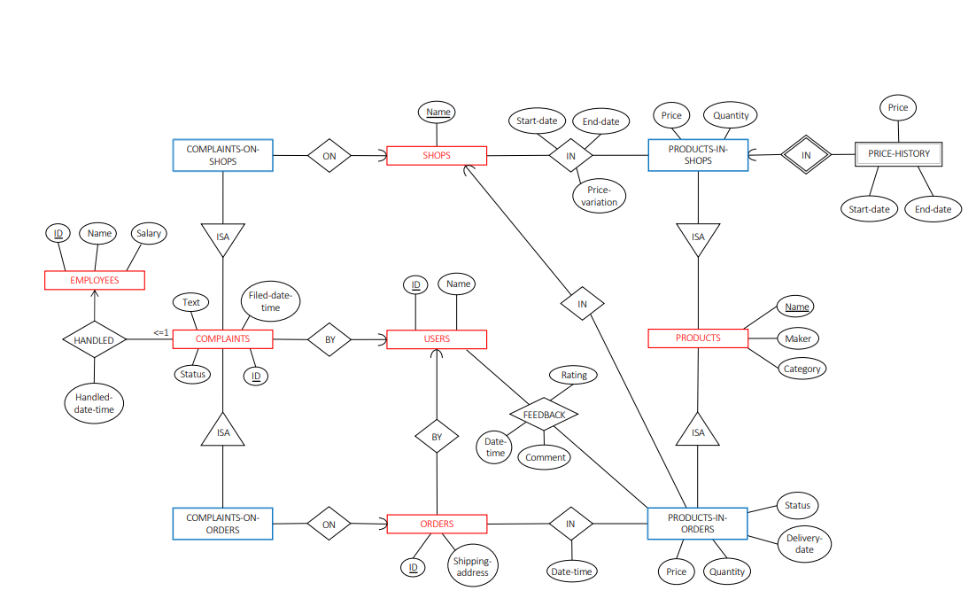
ER Diagram

Slide 3
Tables Created
SHOPS (Shops_name)
USERS
(Users_ID, Users_name)
EMPLOYEES
(Employees_ID, Employees_name, Salary)
ORDERS
(Orders_ID, Shipping-address, Users_ID)
PRICE-HISTORY
(Shops_name, Products_name, PH_price, Start-date, End-date)
PRODUCTS-IN-ORDER
(Shops_name, Products_name, Orders_ID, Status, Delivery-date, PIO_quantity, PIO_price)
PRODUCTS
(Products_name, Maker, Category)
PRODUCTS-IN-SHOPS
(Shops_name, Products_name, PIS_price, PIS_quantity)

Slide 4
Tables Created
COMPLAINTS-ON-ORDERS
(Complaints_ID, Orders_ID, Products_name)
COMPLAINTS
(Complaints_ID, Employee_ID, Text, Status,Filed-date-time, Users_ID)
IN_ORDERSID_
PRODUCTSNAME
(Orders_ID, Products_name, Date-time)
IN_SHOPSNAME_PRODUCTSNAME
(Shops_name, Products_name, Price-variation, Start-date, End-date)
FEEDBACK
(Users_ID, Shops_name, Products_name, Orders_ID, Rating, Comment, Date-time)
COMPLAINTS-ON-SHOPS
(Complaints_ID, Shops_name)
HANDLED
(Employees_ID, Complaints_ID, Handled-date-time)

Slide 5
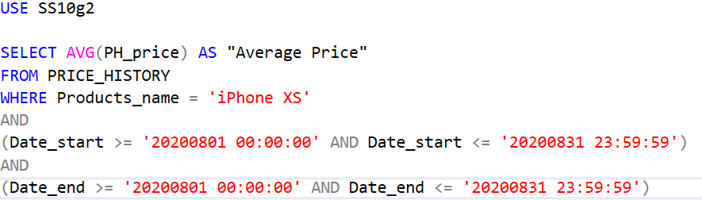
Queries
1
Find the average price of “iPhone XS” on Sharkee from 1 August 2020 to 31 August 2020.

Slide 6
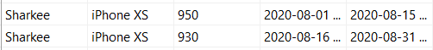
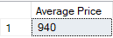
1
Find the average price of “iPhone XS” on Sharkee from 1 August 2020 to 31 August 2020.
Table
Results

Slide 7
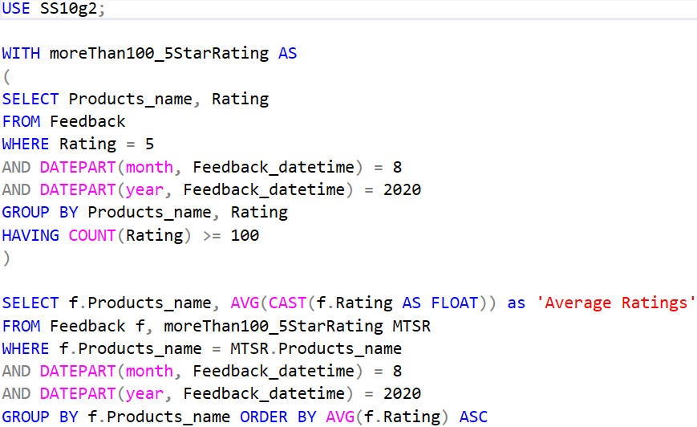
2
Find products that received at least 100 ratings of “5” in August 2020, and order them by their average ratings.
Assume that the total number of products is calculated from all the shops in Sharkee (Search product, search will comeback with the products from all the shops)

Slide 8
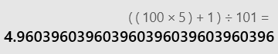
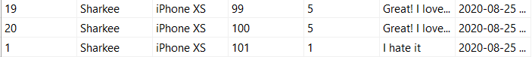
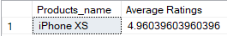
2
Find products that received at least 100 ratings of “5” in August 2020, and order them by their average ratings.
Assume that the total number of products is calculated from all the shops in Sharkee (Search product, search will comeback with the products from all the shops)
Table
Calculation
.
.
.
98 more 5s
Results

Slide 9
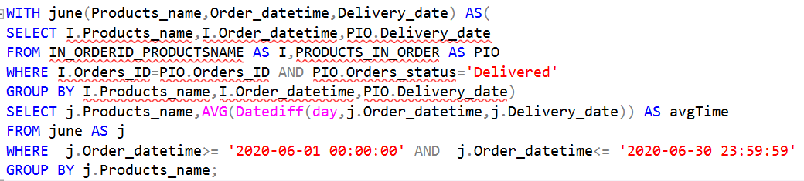
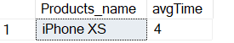
3
For all products purchased in June 2020 that have been delivered, find the average time from the ordering date to the delivery date.

Slide 10
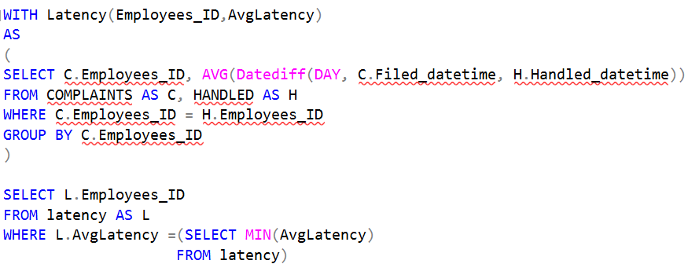
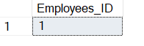
4
Let us define the “latency” of an employee by the average that he/she takes to process a complaint. Find the employee with the smallest latency.
Notes:
--Calculate the difference in days via datediff and find the avg
--group by the employees_ID
--Select the min from the view to obtain smallest latency

Slide 11
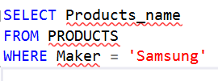
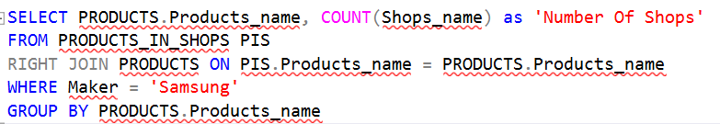
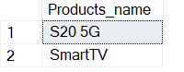
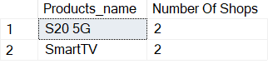
5
Produce a list that contains (i) all products made by Samsung, and (ii) for each of them, the number of shops on Sharkee that sell the product.
(i)
(ii)
(i)
(ii)

Slide 12
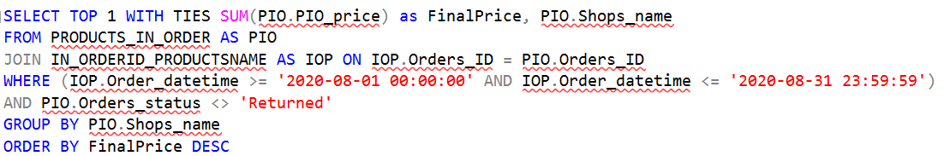
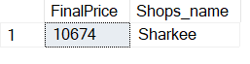
6
Find shops that made the most revenue in August 2020.

Slide 13
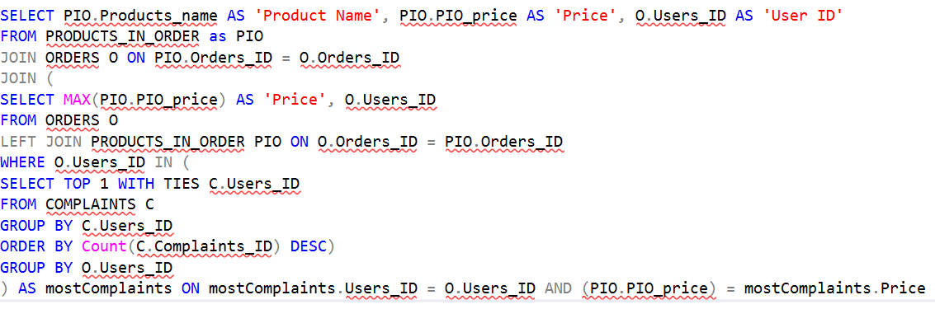
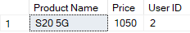
7
For users that made the most amount of complaints, find the most expensive products he/she has ever purchased.

Slide 14
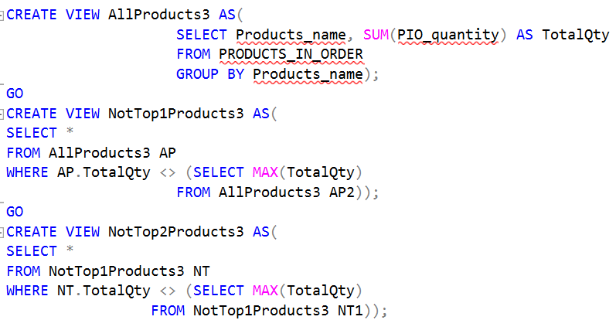
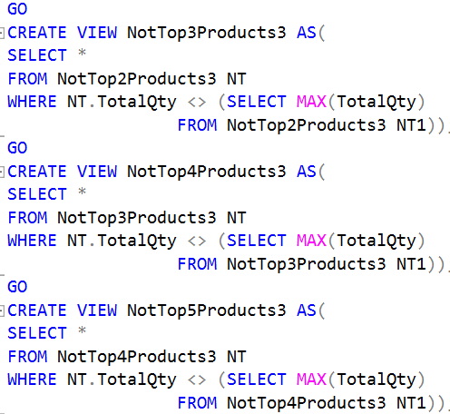
8
Find products that have never been purchased by some users, but are the top 5 most purchased products by other users in August 2020.

Slide 15
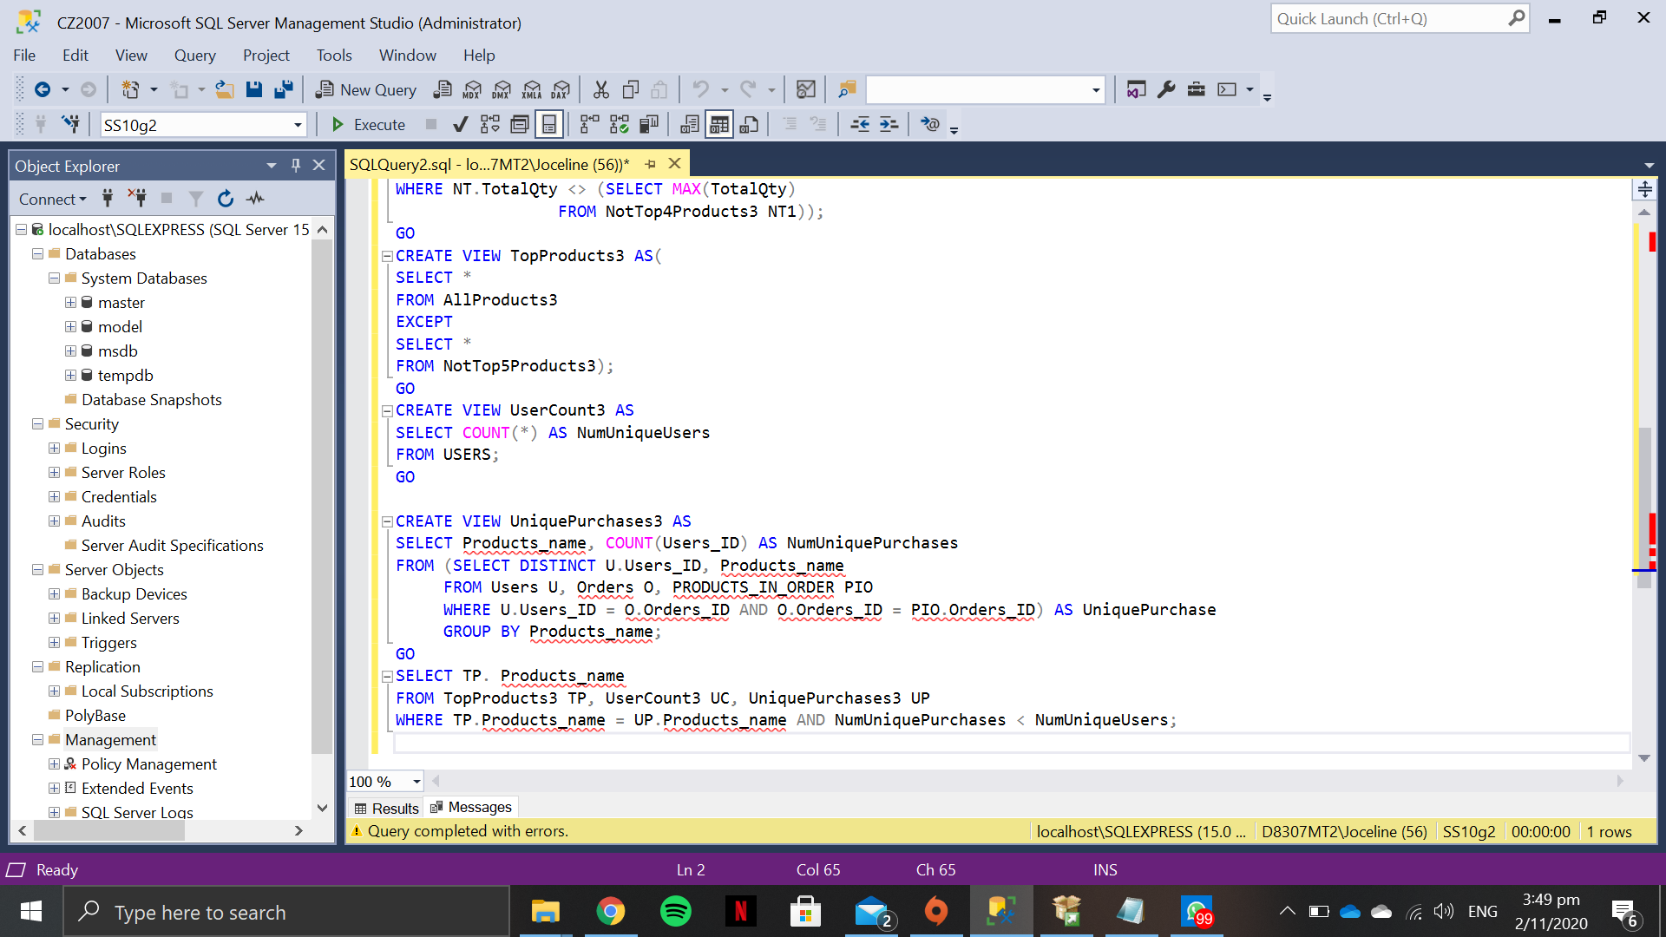
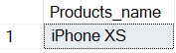
8
Find products that have never been purchased by some users, but are the top 5 most purchased products by other users in August 2020.

Slide 16
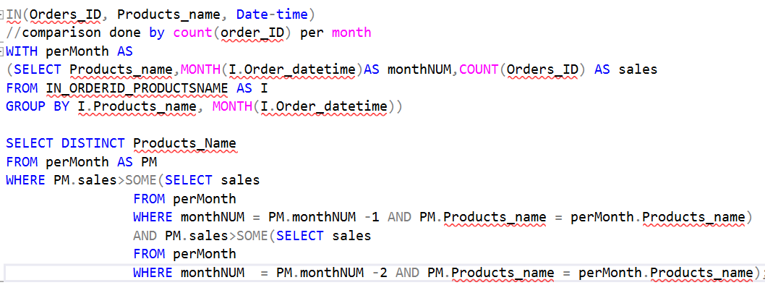
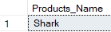
9
Find products that are increasingly being purchased over at least 3 months
Notes:
--comparison done to be done by sales(which consider to be count(order_ID)) per month
--create view for per month
--Comparison with previous months with month-1 and previous month-2

Slide 17
Thank You
Q&A

